Slide 1
PREDICTIVE ANALYSIS ON MEDICINES & DOCTORS AVAILABILITY IN GOVERNMENT HOSPITALS
PIP2001 Capstone Project
Review-4
Batch Number:
Under the Supervision of,
Ms. Shweta Singh
Assistant Professor
School of Computer Science and Engineering
Presidency University
Roll Number | Student Name
20211CSE0363 | MADHU KUMAR V
20211CSE0374 | RAVI SHIVAJI MAHIPATI
20211CSE0385 | TARUN GS
Name of the Program: CSE
Name of the HoD: Dr. Blessed Prince P/Dr. Robin Rohit/Dr.Asif Mohammed H.B
Name of the Program Project Coordinator: Mr. Amarnath J.L & Dr. Jayanthi. K.
Name of the School Project Coordinators: Dr. Sampath A K / Dr. Abdul Khadar A / Mr. Md Ziaur Rahman

Slide 2
Content
Introduction
Literature Review
Research gaps identified
Proposed methodology
objectives
System design and implementation
Timeline of the Project
Expected Outcomes
SDG
Conclusion
References
Publication Details
Achievements

Slide 3
Introduction
Government hospitals in India frequently experience medicine shortages during peak disease outbreaks. This disrupts timely treatment and patient care, creating an urgent need for an efficient solution.
Our system uses analytics to predict medicine needs by evaluating historical and real-time patient data. It generates reports on required medicines and quantities, ensuring adequate stock during critical times.
Doctor availability is also a challenge, especially during peak disease periods, weekends, and holidays. The system analyses patient inflow data to predict the number of doctors required daily and ensures optimal staffing.
This program targets the Indian Government healthcare department, aiming to improve operational efficiency. By addressing medicine availability and doctor resource management, it enhances patient care during high-demand periods.

Slide 4
Literature Review
Sl.No | TITLE | AUTHOR | INFO
1 | More than Technical Perspective: Analysing the possibilities of Unstructured data in Healthcare industry. | Yi Chuan Wang, LeeAnn Kung, Chaochi Ting | The research highlights the underutilization of big data technology in healthcare and aims to improve strategies by exploring its architecture, features, and potential to enhance patient care and medicine availability.
2 | Learning, schooling, and data analytics | Baker, R. S. J. D | Educational Data Mining (EDM) and Learning Analytics (LA) are new approaches that use big data to improve learning. EDM focuses on studying and validating learning models, while LA aims to help teachers improve their methods using research insights.
3 | Big data analytics in healthcare: promises and possibilities. | Raghupathi. W | This paper discusses the benefits of using big data technologies in healthcare, focusing on frameworks and methodologies to improve efficiency, reduce costs, and advance the system with modern technologies like AI and machine learning.

Slide 5
Research Gaps Identified
Lack of Real-Time Data Use
Most systems rely only on past data and do not use live updates from hospitals or other sources.
Limited Consideration of Local Needs
Current models don’t consider regional differences like disease patterns or population demands.
No Link Between Predictions and Hospital Actions
Predictive systems are not fully connected to hospital workflows like stock management or doctor scheduling.
Poor Handling of Emergencies
Existing methods don’t predict medicine or doctor shortages well during unexpected outbreaks or busy periods.
Complex Tools for Staff and Patients
Prediction tools are not user-friendly, making it hard for staff and patients to use them effectively.

Slide 6
Methodology/Modules
1. Authentication and Security
User Authentication: Patients sign up with name, email, and password. They log in to access features like doctor availability.
Staff Authentication: Staff log in with predefined credentials and role-based access to manage doctor and medicine data.
Data Security: Sensitive data is encrypted, and users can access only relevant information based on their roles.
2. Doctor Availability Predictor (User Side)
Specialization: Choose the doctor type (e.g., General Physician, Cardiologist).
Patient Load: Input the number of current appointments for the selected doctor.
Location: Select the hospital or city to check availability.
Prediction Output:
Probability < 0.4: "Doctor Not Available."
Probability ≥ 0.4: "Doctor Available."
3. User Interface for Updating Details
Update Button: Allows editing of name, email, age, gender, address, and phone number.
Save Changes: Validates inputs and updates data with a confirmation message: "User details updated successfully."

Slide 7
Methodology/Modules
4. Staff Dashboard
Medicine Availability:
Select medicine type, dosage, and location. Click "Predict" for availability:
< 0.4: "Medicine Not Available."
≥ 0.4: "Medicine Available."
Doctor Management: Search, add, or delete doctor details from a CSV database.
Medicine Management: Search, add, or delete medicine details in a CSV database.
5. Data Fetching
Doctor Details: Fetched from a CSV file with doctor profiles (e.g., name, specialization).
Medicine Details: Fetched from a CSV file with stock levels and dosage details.
6. Supabase Database Structure
User Table: Stores patient login data (users).
Staff Table: Stores staff credentials and roles (staffs).
Unified Authentication: Manages both patients and staff (auth.users).

Slide 8
Objectives
Predict Medicine Availability with Real-Time Data
Optimize Doctor Availability Based on Patient Load
Integrate Predictive Analytics into Hospital Operations
Secure and User-Friendly Authentication System
Provide Dynamic Doctor Availability Predictions for Users
Allow Users to Update Personal Information Efficiently
Real-Time Medicine Availability Monitoring for Staff
Enable Staff to Manage Doctor and Medicine Data
Implement Database Integration for Efficient Data Fetching
Enhance Reporting and Analytics for Healthcare Management

Slide 9
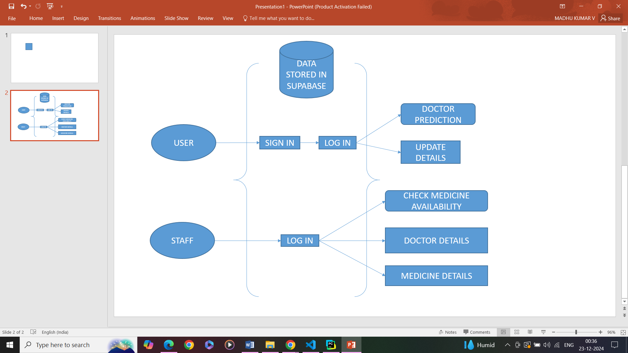
System Design

Slide 10
implementation
The Proposed method consists of the following steps:
• Step 1: User Authentication – Signup and login for patients with secure credentials.
• Step 2: Staff Authentication – Staff login with predefined credentials for role-based access.
• Step 3: Doctor Availability Predictor – User selects doctor type, enters appointments, selects location, and gets availability prediction.
• Step 4: Update User Details – Users can update their personal details and save changes with validation.
• Step 5: Staff Dashboard – Staff can manage medicine availability, doctor details, and medicine details via CSV editor.
• Step 6: Data Fetching – Fetch doctor and medicine details from respective CSV files.
• Step 7: Supabase Database Structure – Store login details in "users" and "staffs" tables, using "auth.users" for unified authentication

Slide 11
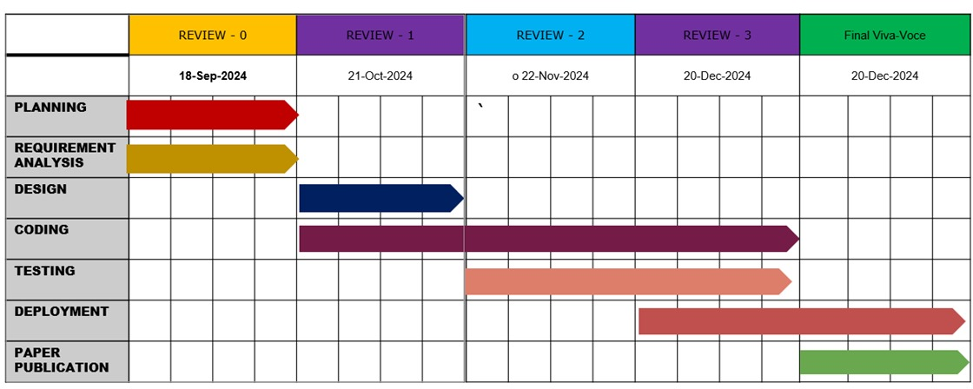
Timeline of Project

Slide 12
Expected Outcomes
Improved Medicine Availability: Accurate forecasts ensure timely stock of essential medicines during peak periods.
Optimized Doctor Allocation: Dynamic scheduling meets patient needs during high-demand times like weekends and holidays.
Enhanced Operational Efficiency: Real-time data and reports streamline hospital resource management and decision-making.
Reduced Patient Wait Times: Better doctor availability minimizes delays in treatment during disease outbreaks.
Informed Government Planning: Predictive insights support government healthcare policies and planning.

Slide 13
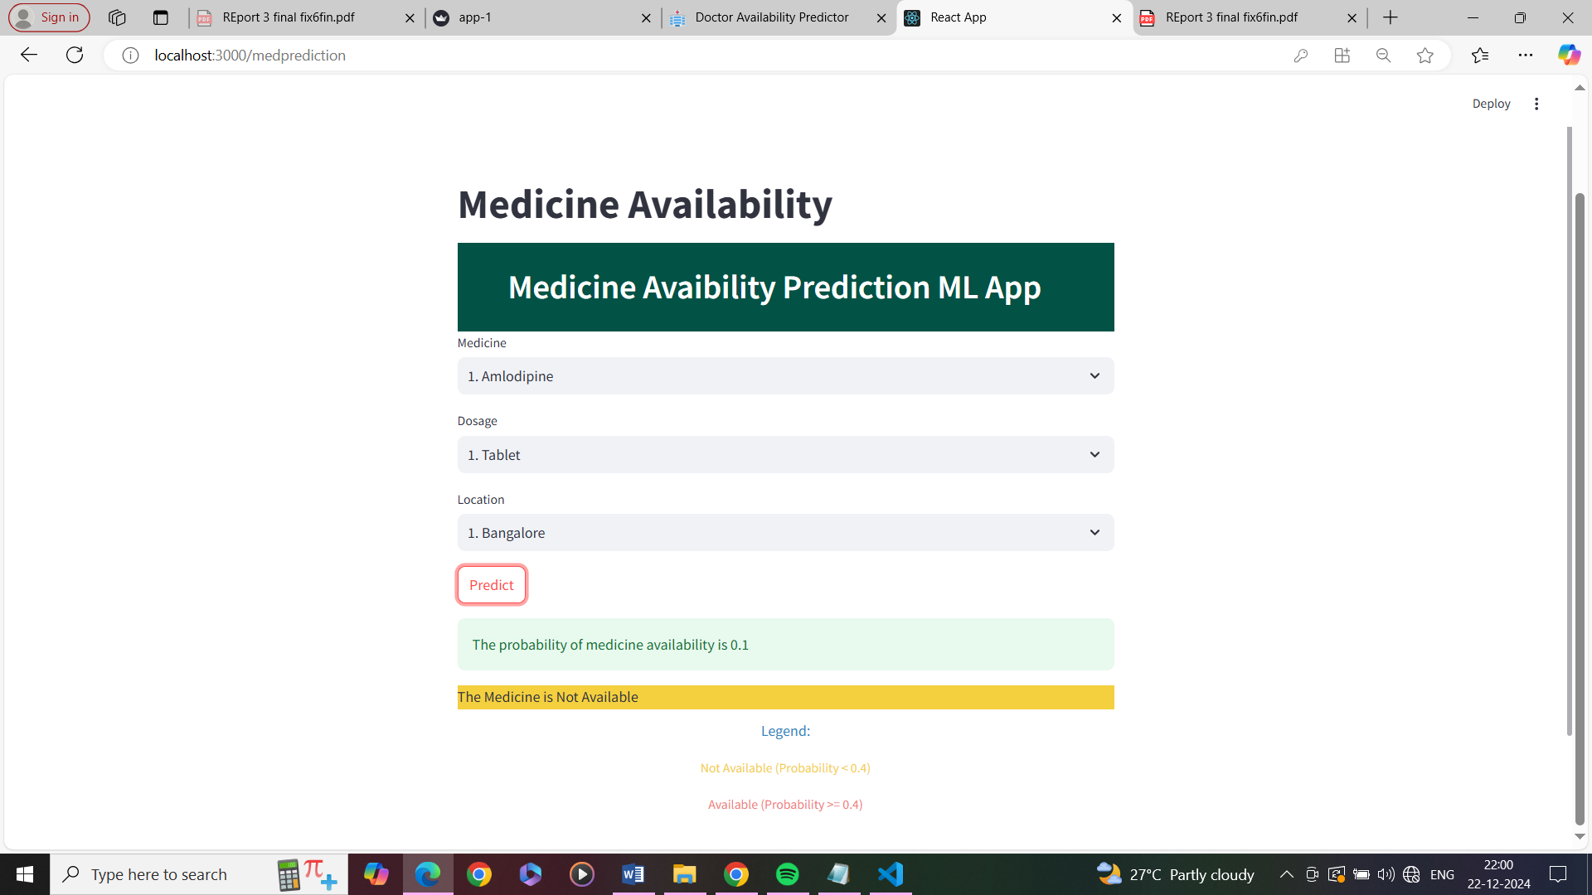
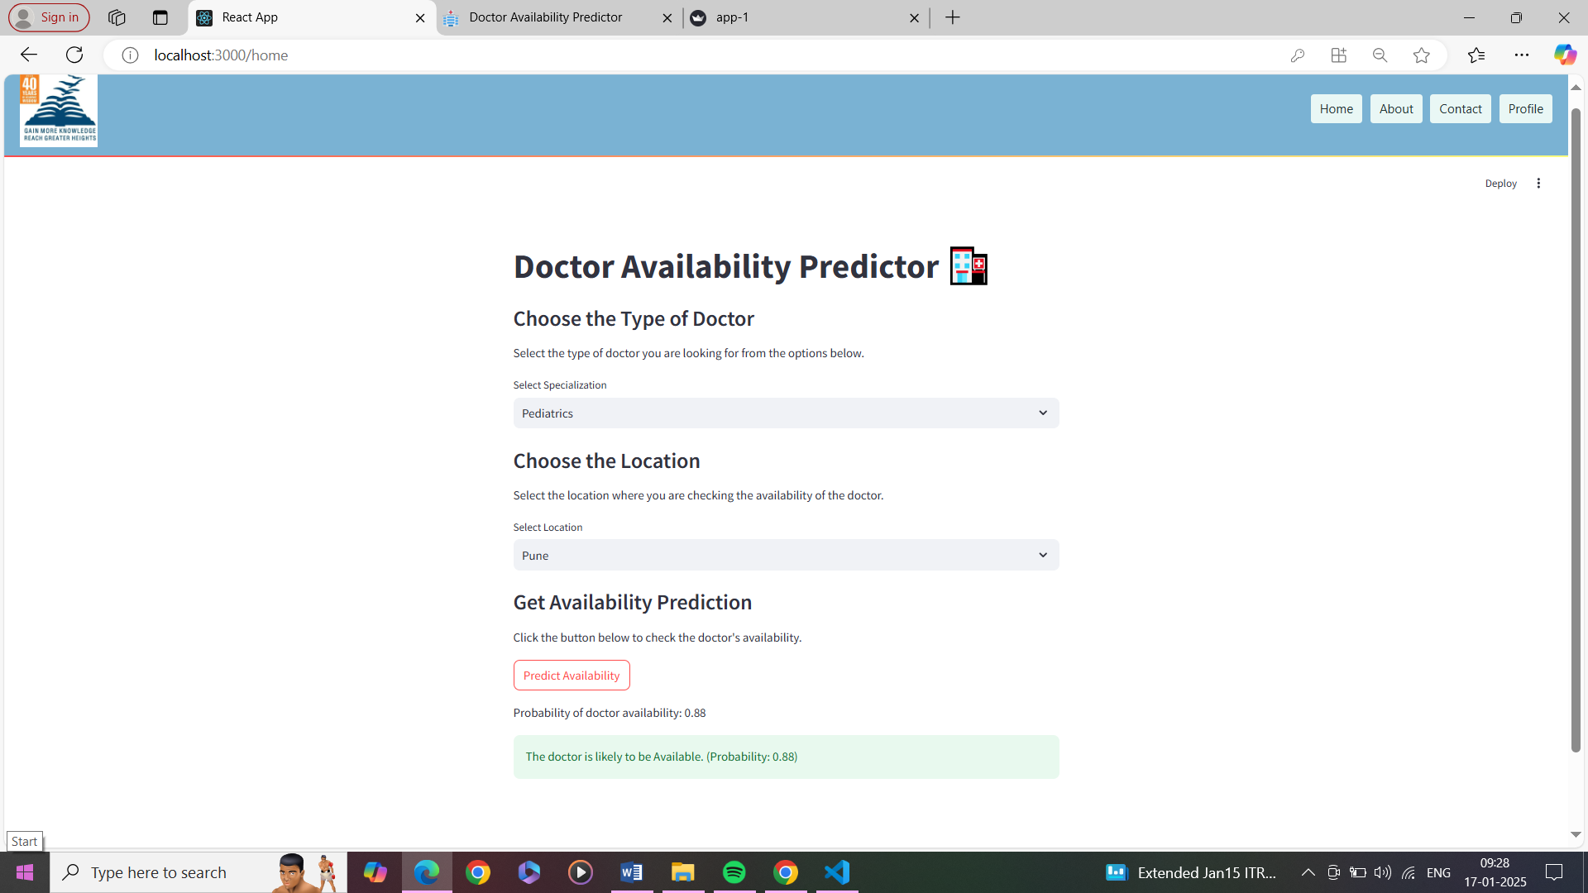
Outputs

Slide 14

Project work mapping with SDG
The topic of predictive analysis on medicines and doctors' availability in government hospitals aligns with SDG 3: Good Health and Well-Being. This goal focuses on access to quality healthcare services and essential medicines for all. Predictive analysis can be used to identify gaps in medical resources, optimize supply chains, and predict future needs. Through data-driven insights, hospitals can ensure a more efficient allocation of medicines and healthcare professionals, minimizing shortages and improving patient outcomes.

Slide 15
Conclusion
Government hospitals face significant challenges during peak disease times due to medicine shortages and doctor unavailability. Our system offers a solution by leveraging analytics for better resource management.
By predicting medicine requirements through historical and current patient data, hospitals can maintain adequate stock. This ensures patients receive timely treatment, even during high-demand periods.
Similarly, the system optimizes doctor availability based on patient inflows, preventing shortages during critical times. This improves patient access to necessary care during weekends, holidays, and peak disease outbreaks.
Overall, this program, targeting the Indian Government healthcare sector, enhances operational efficiency. It ensures hospitals are well-prepared to handle surges in patient numbers, improving overall healthcare outcomes.

Slide 16
Github Link
Github Link:
https://github.com/predictiveAnalysisonMedicinesDoctors

Slide 17
References
[11] Patel, S. (2024). Managing healthcare resources effectively during peak times. Healthcare Management Review, 35(3), 89-101. https://journals.lww.com/healthcaremanagement/Fulltext/2024/05000/Managing_Healthcare_Resources_Effectively_During.10.aspx
[12] Barlow, M. A., & Vassallo, S. R. (2023). Optimizing medicine inventory management using predictive analytics. IEEE Transactions on Biomedical Engineering, 70(1), 25-34. https://ieeexplore.ieee.org/document/9348765
[13] Smith, J. (2023). Improving hospital efficiency with predictive modelling of doctor availability. International Journal of Health Information Systems and Informatics, 19(4), 45-59. https://www.igi-global.com/article/improving-hospital-efficiency/210586
[14] Sharma, K., & Patel, R. (2022). Enhancing healthcare resource management with patient inflow prediction. Journal of Healthcare Management, 18(3), 56-68. https://www.journalofhealthcaremanagement.org/article/7568998
[15] Singh, P., & Kumar, A. (2021). Predictive analytics for doctor and specialist allocation in hospitals. International Journal of Medical Informatics, 140, 104136. https://www.sciencedirect.com/science/article/abs/pii/S1386505619310312
[16] Gupta, V., & Mehta, S. (2020). Improving medicine stock availability using data-driven strategies. Health Systems Management Review, 44(2), 103-110. https://www.healthsystemsreview.org/articles/4031057

Slide 18
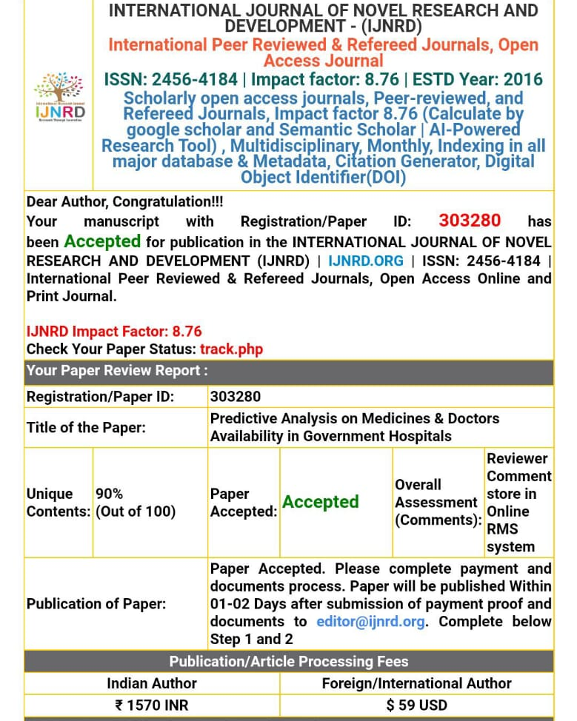
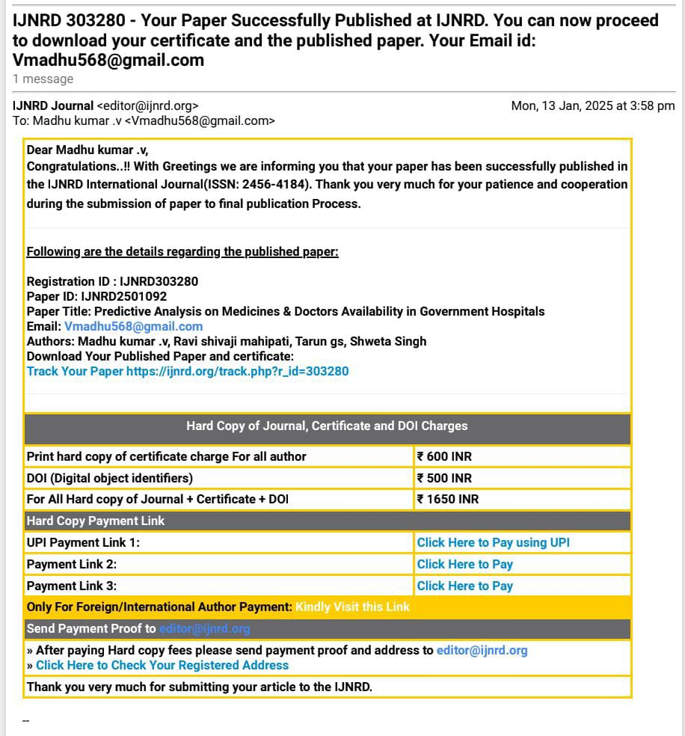
Publication details

Slide 19


Achievements

Slide 20
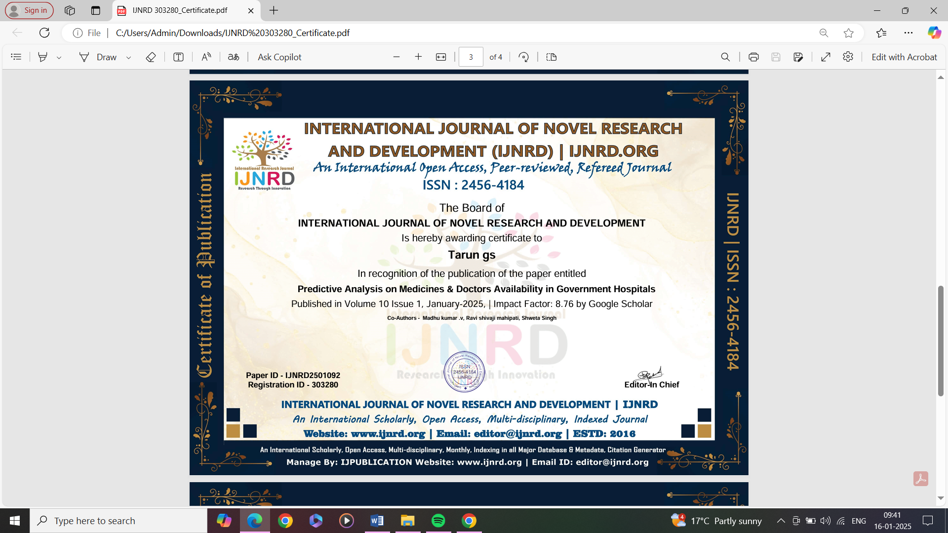

Achievements

Slide 21
Thank You

